Slide 1
Extended analysis of tostada database pb2 chile data
Used most current Chile database entry: pb2a-20200818
Kyle Devereaux
11/22/2020
Initial analysis is here.
Code is here.

Slide 2
Runid reference table
Modifications were made on the receiver between the 200******, 201******, and 212****** runs.
Many differences and nonlinearities between temperature data sets can be explained by considering the data separately in these three periods:
 | First runid | First date | Last runid | Last date
Original receiver | 20000021 | 2018-12-26 | 20000327 | 2019-03-06
After first round of modifications | 20100001 | 2019-03-08 | 20102003 | 2019-11-30
After second round of modifications | 21200001 | 2020-01-30 | 21200399* | 2020-03-19
*most recent run in database
All iceboard temperatures are in °C. All other temperatures are in K.

Slide 3
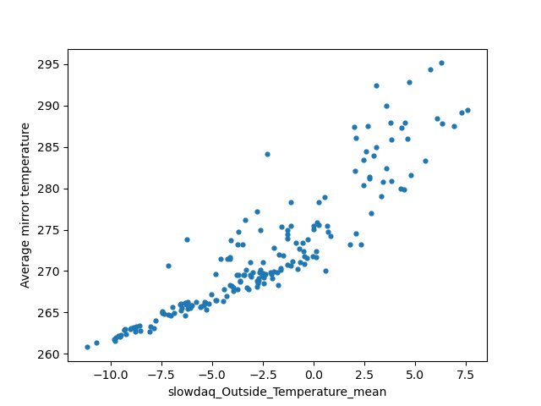
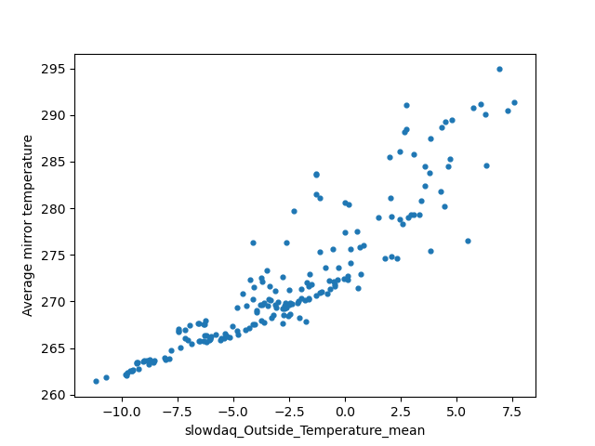
Mirrors: Nonlinearity in temperature of mirrors
In the first analysis, it was found that certain locations on the primary and secondary mirrors unexpectedly had nonlinear relationships with the outside (above are the center-left locations on each mirror).
To confirm that this nonlinearity occurs for all locations on the mirror (on average), and not simply the center-left location, I found the average temperature of all locations for a given runid and plotted this against the outside temperature with the same runid. (below). The average mirror temperatures are still nonlinear.
Primary mirror Secondary mirror

Slide 4
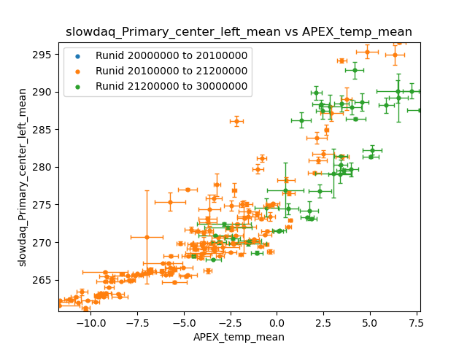
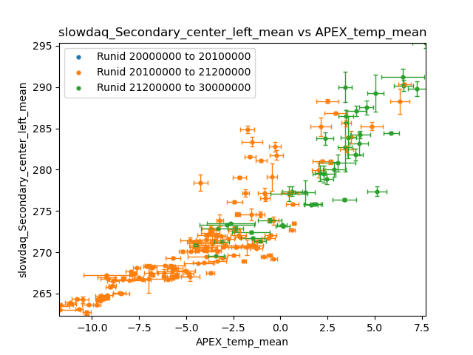
Mirrors: explanations for nonlinearity - error
Plotted are the temperature relations for the center-left mirror locations for both mirrors. Error bars represent +/- 1 sd in the data. The error increases with temperature, with the error at the highest temperatures being quite high (+/- ~2K for both mirrors). This pattern occurs for all the other mirror locations as well.
The data is also colored by range of runid taken. The nonlinearity exists in both runid sets.

Slide 5
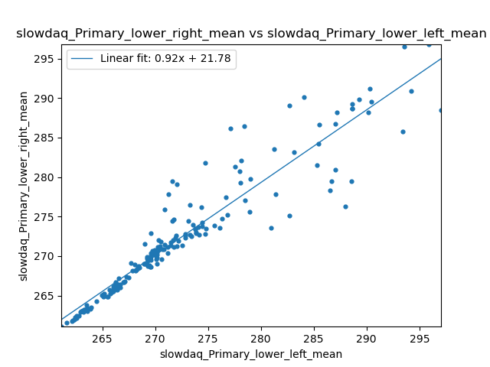
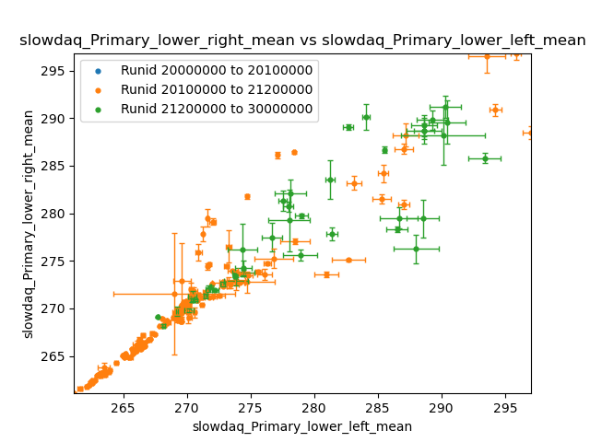
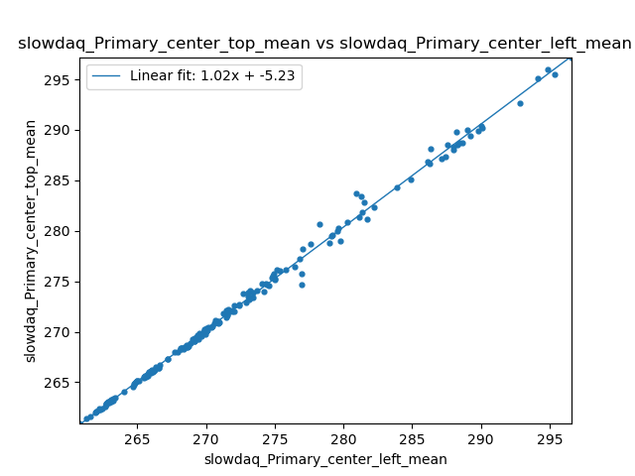
Mirrors: explanations for nonlinearity - error in comparing primary components
Some components of the primary are highly linearly correlated at all temperatures. Example: (left) center-left and center-top.
Some components have very poor correlation - specifically at higher temperatures. Example (middle): lower-left and lower-right. This lack of correlation may be explained by the large increase in temperature measurement error as temperature increases (right). So, at higher temperatures, the

Slide 6
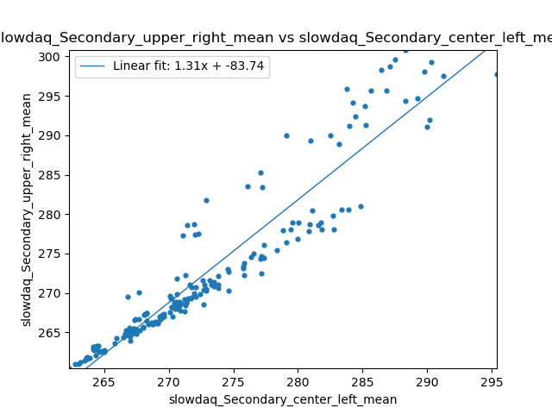
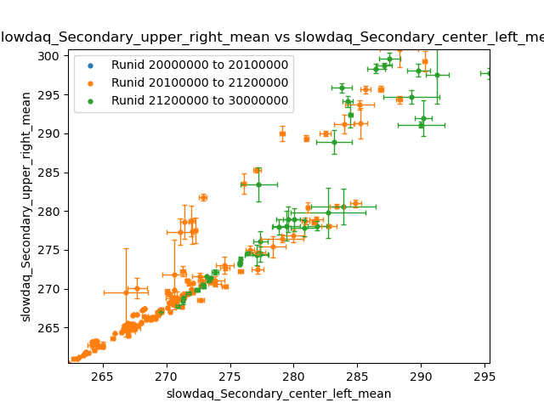
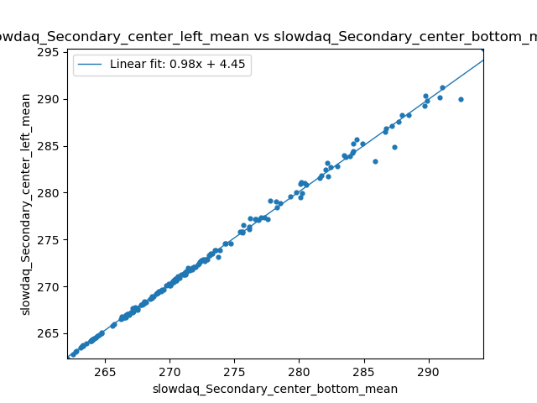
Mirrors: explanations for nonlinearity - error in comparing secondary components
The same error occurs for the secondary mirror.

Slide 7
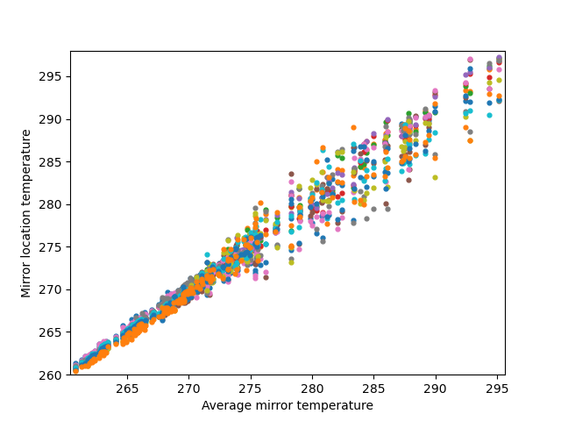
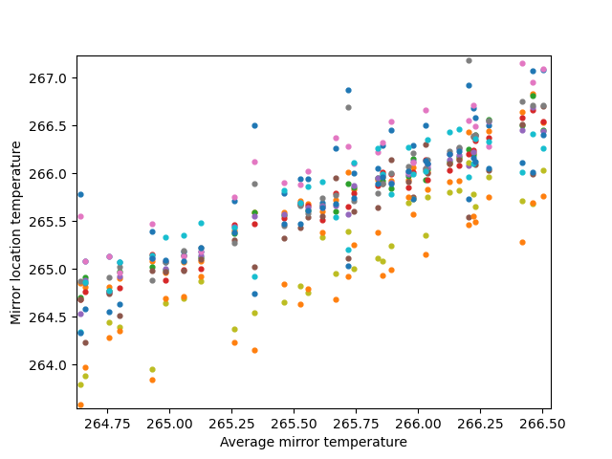
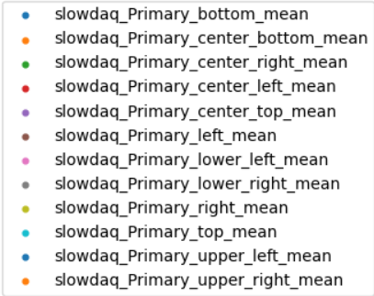
Mirrors: temp differences across the Primary mirror
While error most likely accounts for the nonlinearity, it’s interesting to consider the temperature differences across locations on the mirrors. Below, the temperature for every location on the mirror is plotted wrt the average mirror temperature.
For low average mirror temperatures (<275K), mirror locations consistently can be ordered by their temperatures. For example, “bottom” is most often relatively the warmest and “upper-right” is often relatively the coldest. For high temperatures (>275K), none of the mirror locations have a consistent temperature ordering. (Probably due to error described in slide 4)

Slide 8
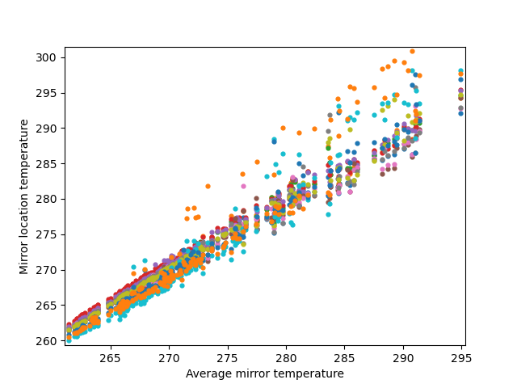
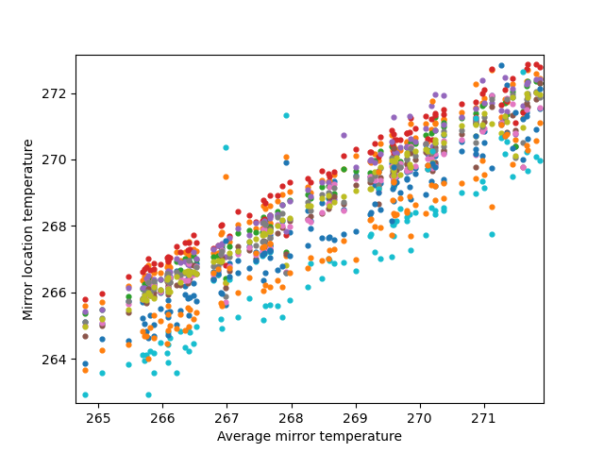
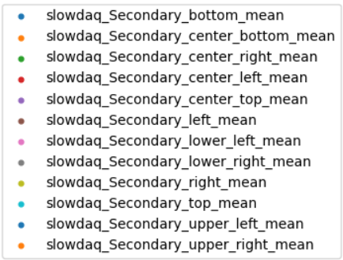
Mirrors: temp differences across the Secondary mirror
Similarly to the primary mirror, for low average mirror temperatures (<275K), secondary mirror locations consistently can be ordered by their temperatures.
However, for high temperatures (>275K), the secondary mirror still has a rough temperature ordering for each of the mirror locations. For example, “center-bottom” is consistently warmer than all the other locations for high average temperatures (it is warmer to the point that error can’t account for this difference). Furthermore, “center-bottom” is also the second warmest for low average temperatures.
Actually on the center-bottom, top, and right locations have diverging temperatures

Slide 9
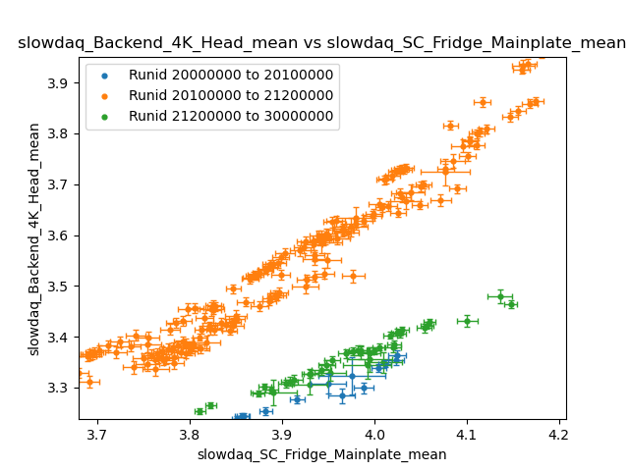
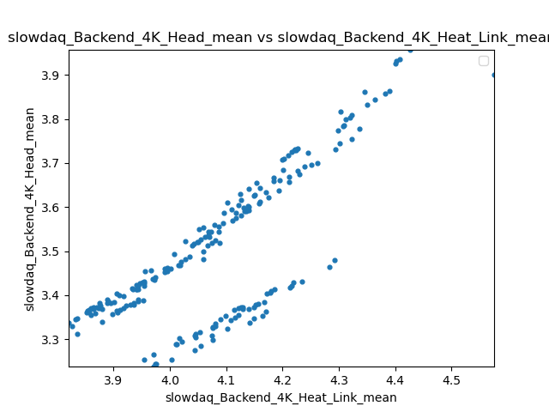
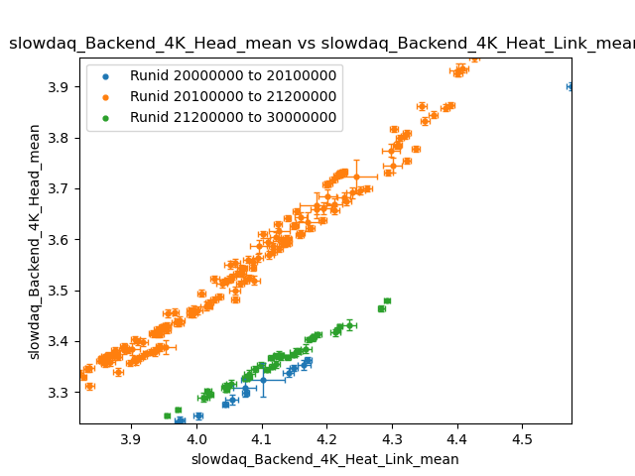
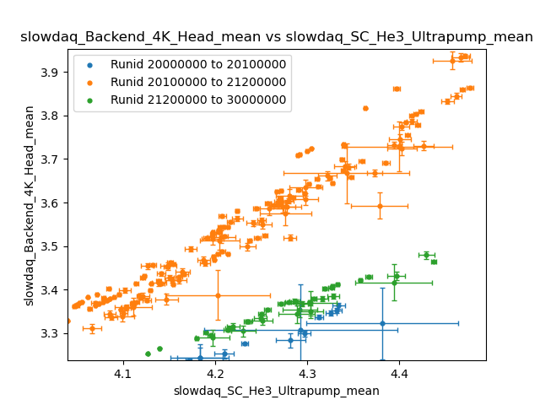
Backend 4K head temp varies significantly across receiver work
After the receiver work done between the 200****** and 201******* runs, the 4K head temperature afterwards was ~0.2K higher on average. (with respect to the 4K heat link and sc-components).
And after the receiver work between the 201****** and 212****** runs, the 4K head temperature returned to levels similar to the 200****** runs.

Slide 10
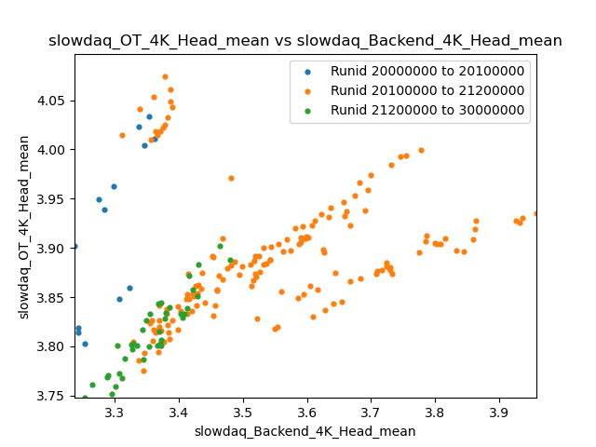
OT 4K head and the Backend 4K head
The backend 4K head averages about 0.4K colder than the optical tube 4K head, and there is no clear relationship between the two (expected).
This estimated difference is very rough since the error for each temp measurement in the graph (not shown) is +/- ~0.2K.

Slide 11
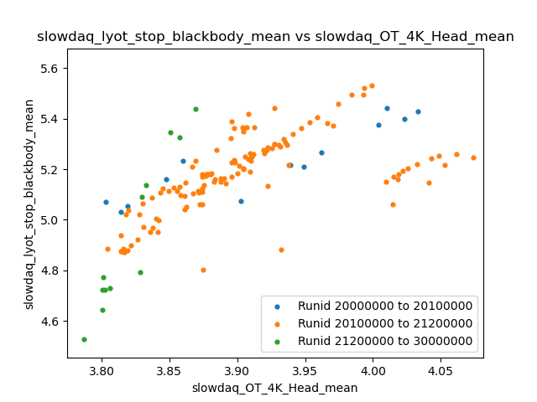
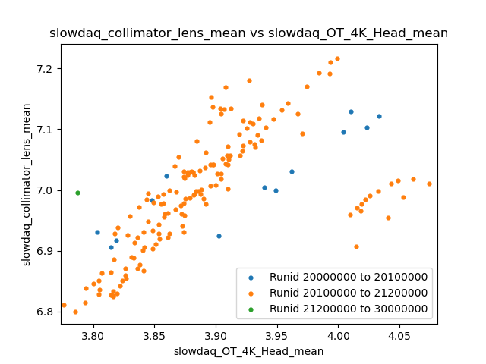
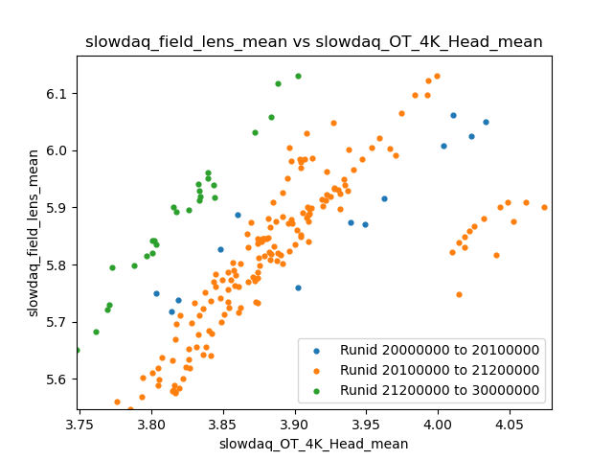
4K OT head relationships with lyot stop, collimator and field lens
All have a very rough linear relationship wrt the OT 4k head. Each component is a few kelvin warmer than 4k fridge head (expected?)
Field lens: for 212****** runs, the field lens is ~0.2K warmer than the previous runs.
Note: each plot’s outliers at ~200 K were discarded.

Slide 12
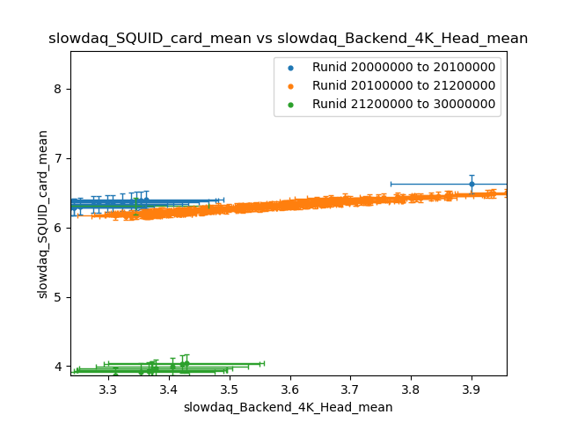
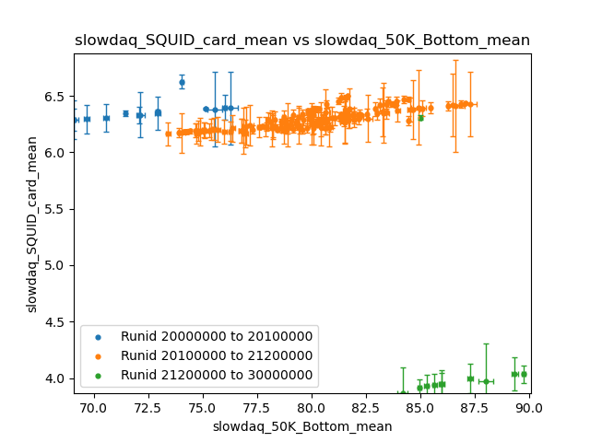
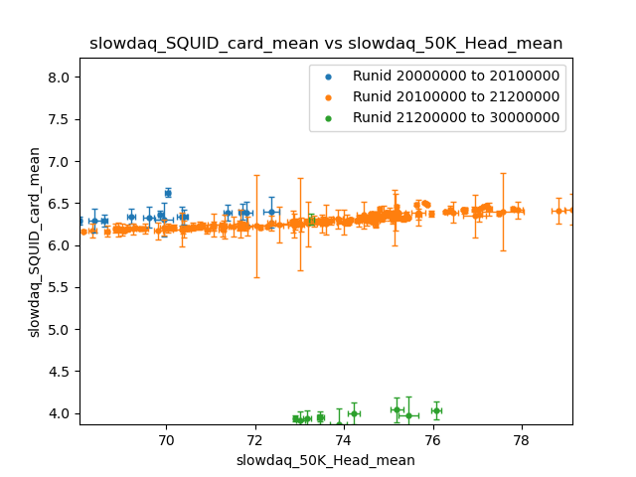
SQUID colder on 212****** runs
Backend fridge more-effectively cools the SQUID after the last period of receiver work.
As seen, the SQUID is ~2K colder on these later runs (green).
Shown are the plots for the SQUID temp wrt to to backend fridge components: the 4k head, 50k head. The bottom left plot is with wrt the 50k bottom, for reference.

Slide 13
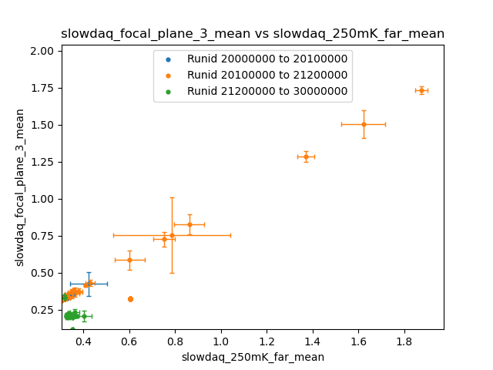
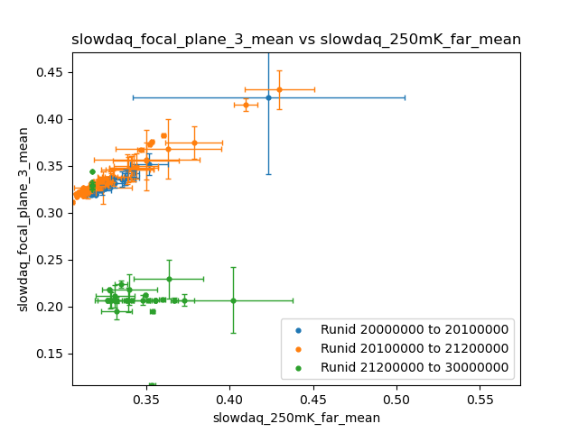
Focal plane colder on 212****** runs: 250mK stage
For 200 and 201****** runs, the temperature of the focal plane and the 250mK far sensor have a close linear correlation. I assume that the data above for temperatures >0.4K are data from warmup/cooldown.
For 212****** runs the focal plane is colder by >0.1K. It’s hard to establish if, for these runs, the focal plane has less of a linear relationship with the 250mK. It seems like the focal plane is mostly independent wrt the 250mK stage and is at a constant 0.2K.

Slide 14
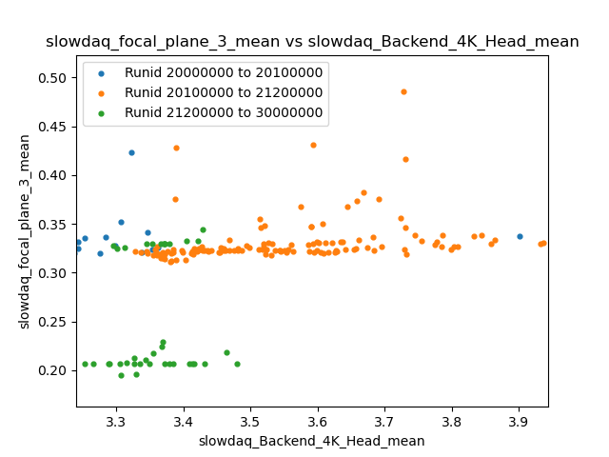
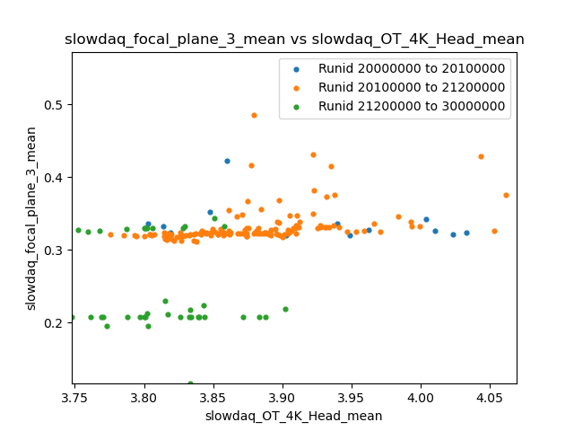
Focal plane colder on 212****** runs: 4K heads
The same is reflected in the data for the 4k heads (backend and OT)
The focal plane temperature is constant with respect to the OT and backend 4k fridge heads (with the exception of a few outliers).
For runs before the 212****** receiver work, the focal plane temperature was ~0.33K, and afterwards, the focal plane temperature was lower to ~0.2K.

Slide 15
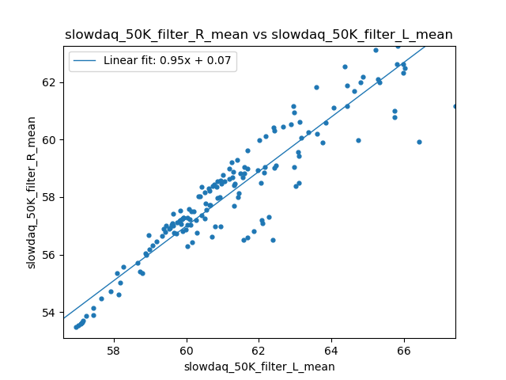
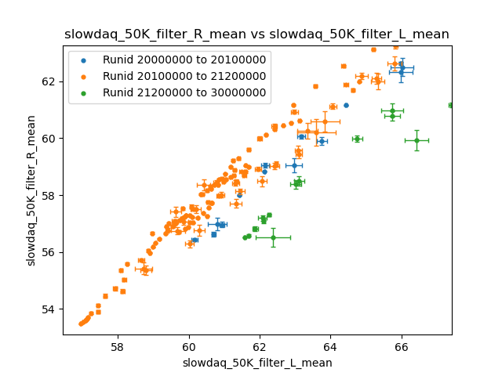
50K filter left-right temperature differences
One would expect a larger linear correlation between each side of the 50K stage filter, especially for the relatively small error in the temperature readings. However, the 200****** to 201****** and 201****** to 212****** sets independently have high linear correlation. For these runs, the left side of the filter is consistently ~2K warmer than the right side. The 212****** and onward runs have the left side of the filter an additional ~2K warmer, and this set has poor linear correlation - but this may be a consequence of a small data set and higher error than the other the runid sets.

Slide 16
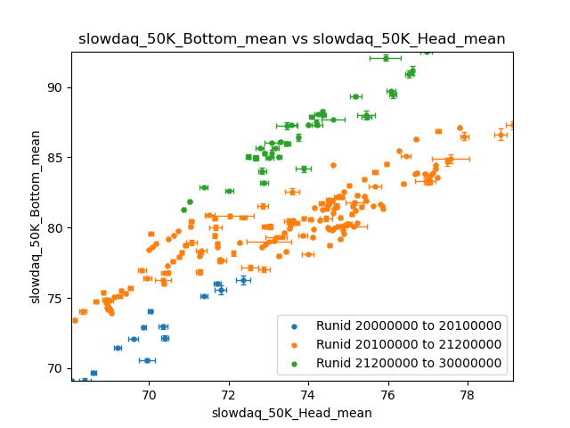
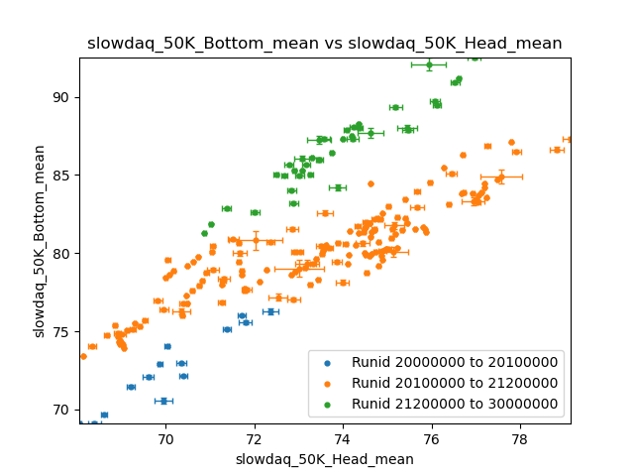
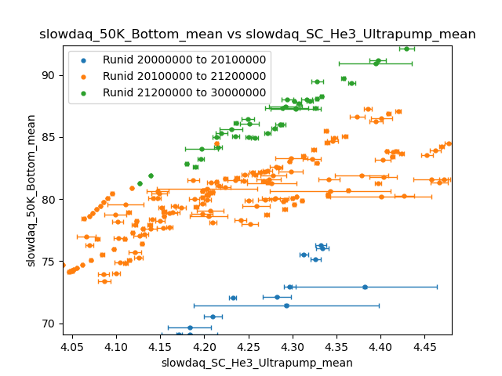
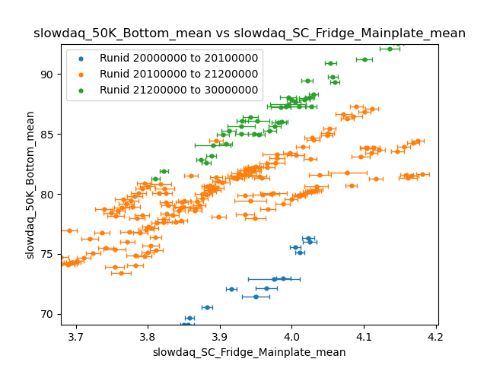
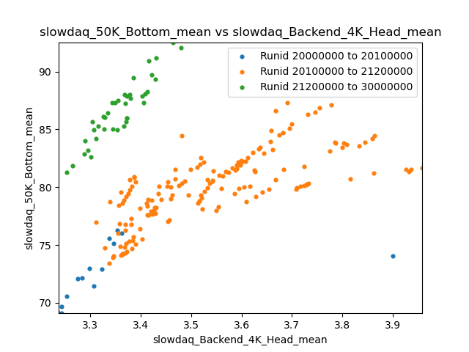
50K bottom vs backend SC cryo components: interesting
Interesting that the 50K bottom has such poor correlations wrt the refrigeration components (esp the 50K head).
Plotted are the 50K bottom’s relationships to four SC fridge components: 4k head, 50k head, he3 ultrapump, and mainplate
212****** runs have the 50K bottom markedly warmer by ~5K relative to the 201****** runs.
The 201****** runs are a further ~5K warmer than the 200****** runs.
50K bottom: ranges in temperature ~68-93 K, quite off from 50K

Slide 17
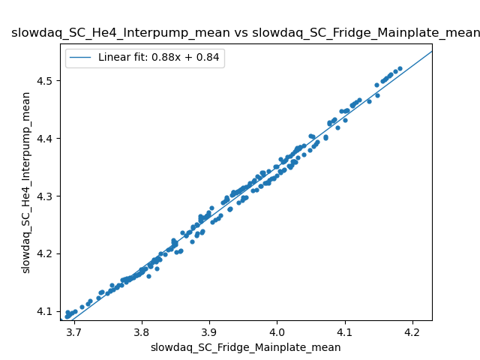
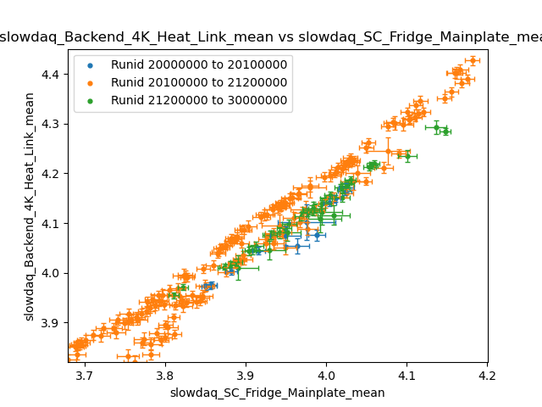
SC fridge components more correlated for 212****** runs
The SC mainplate roughly has a linear relationship wrt the other fridge components (shown above are the He4 interpump and backend 4k head as examples). However, for runs 201****** to 212******, the relationship involves two distinct subsets separated by ~0.05K in the mainplate temperature. For the 200****** to 201****** and 212****** onwards runids, however, the mainplate temperature is more aligned with the rest of the fridge components.

Slide 18
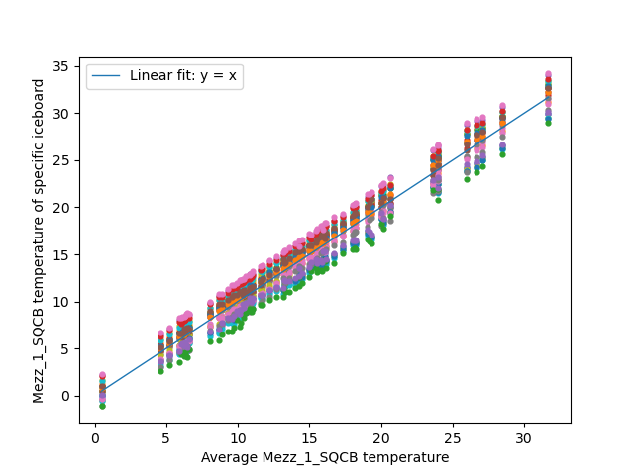
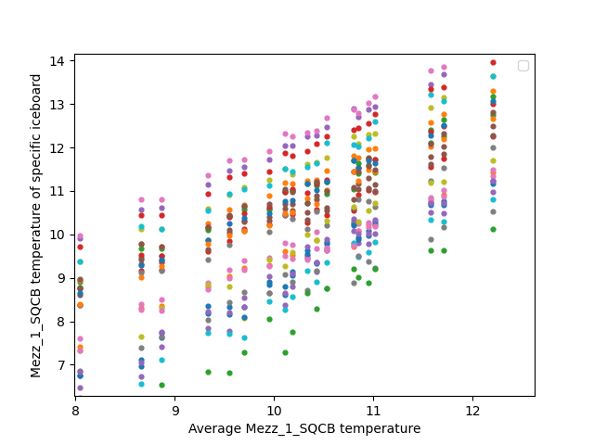
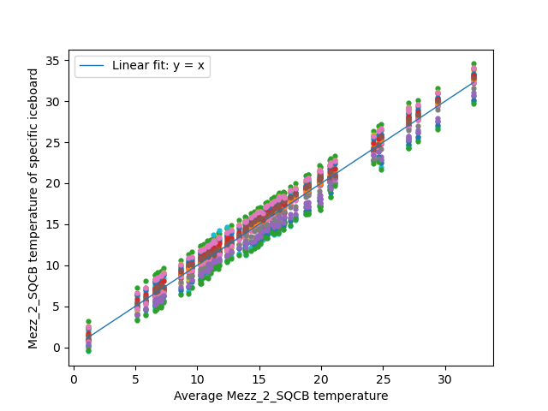
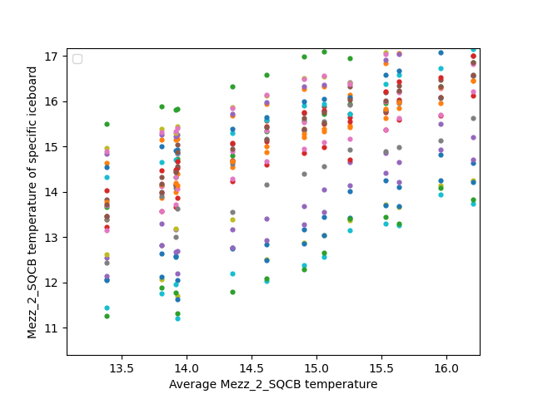
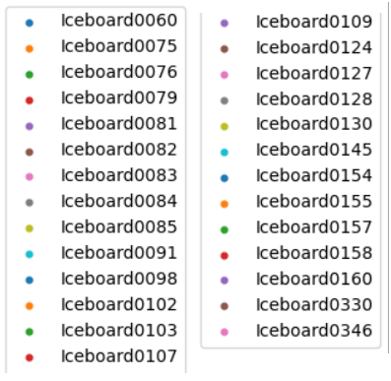
Iceboard: linear relationships
The SQCB (for both Mezzanines) is the only iceboard component which has a strictly linear relationship with the average iceboard temperature.
Notice that no two SQCBs are more than 5°C in difference, and for all times, the SQCBs have the same temperature ordering across the iceboards.

Slide 19
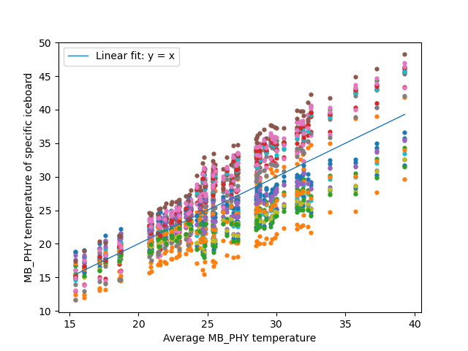
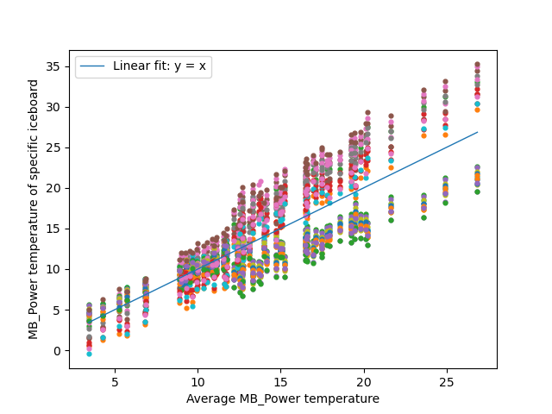
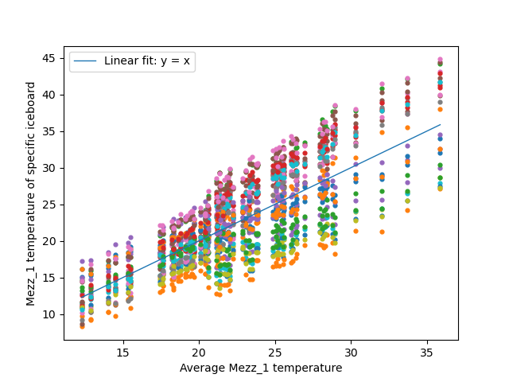
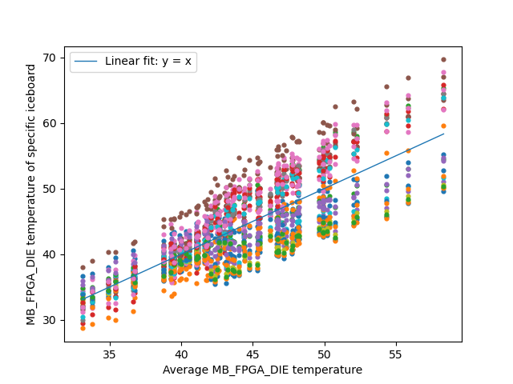
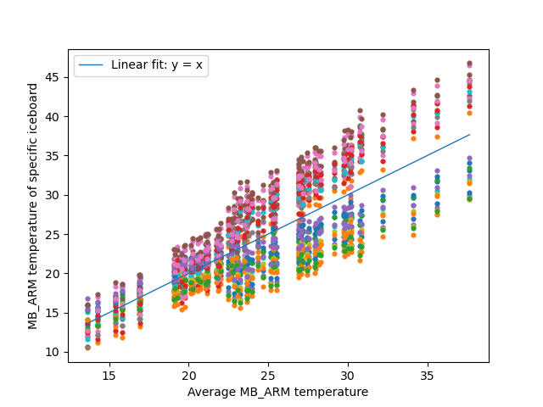


Iceboard: nonlinear relationships
All other iceboard components (MB_PHY, MB_Power, Mezz 1, Mezz 2, FPGA, FPGA DIE, ARM) are linear for small temperatures.
At temperatures ~10°C above each components minimum, the relationship becomes nonlinear.
Two distinct subgroups form above and below the component’s average temperature. (above and below the fit line)

Slide 20

Iceboard: nonlinear relationships contain contrary motion
A closer look at one of the nonlinearities at high temperatures. We look at the MB_PHY components, but applies to all the nonlinear components.
High temp subset: Iceboards 60, 79, 81, 82, 84, 109, 124, 127, 128, 158, 330, 346
Low temp subset: Iceboards 75, 76, 83, 85, 91, 98, 102, 130, 145, 154, 155, 157, 160
Interesting: when warmer subset gets warmer, colder subset gets colder (and vice versa)

Slide 21

Iceboard: work on receiver
A possible explanation for these nonlinearities.
After the second round of work on the receiver, Iceboard component temperatures rose ~10K on average for each component. 212 subset also has much higher standard deviation/error than the 201-212 subset.
Example: Iceboard76 MB_PHY component plotted wrt outside temp. The 212- subset and 201-212 subsets are clearly disjoint and are seperated at ~27℃.

Slide 22

Iceboard
27 iceboards
9 sensors per
Greatest error is 2°C for any measurement
Temperature correlations between all sensors are quite high (right)

Slide 23




Iceboard: interesting correlation data spread
Plotted is the correlation coefficient distribution for every combination of two iceboard components. Most are correlated very highly. Upon inspection, the vast majority seem to be linearly correlated. So, I applied a linear fit to each plot, collected the y-intercept and slope data and plotted them.
Color in the plot represents correlation coefficient of the set (redder is more correlated)

